Slide 1
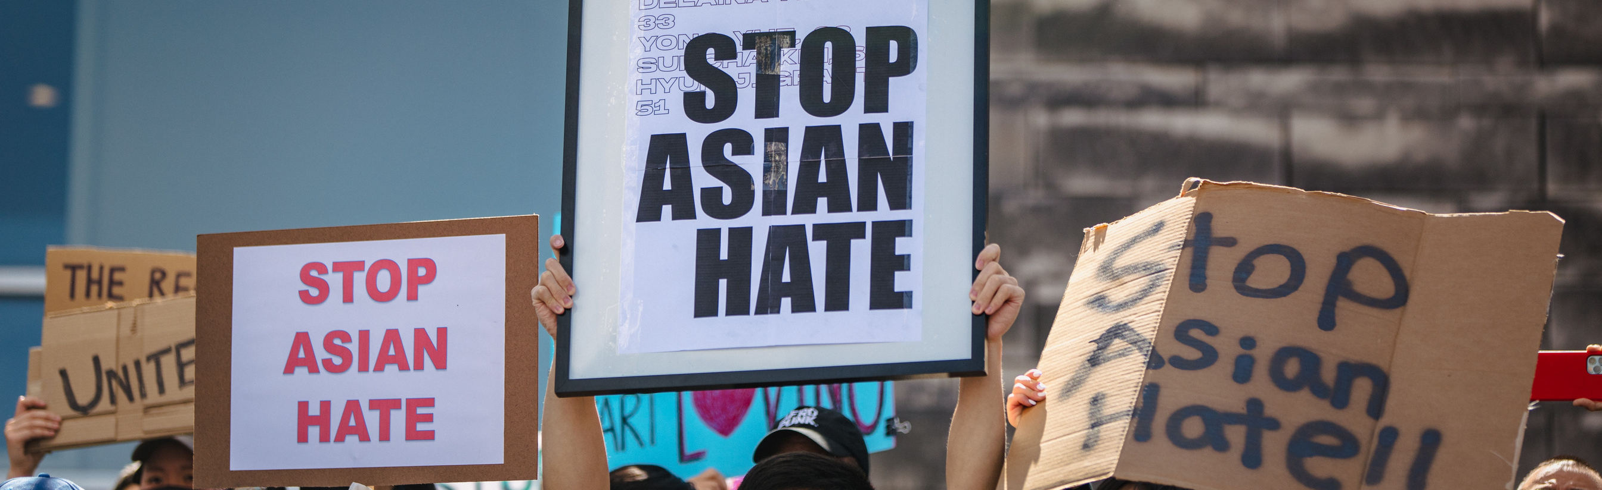
SOCIAL MEDIA ANALYSIS OF ANTI-ASIAN TWEETS
Gowtami Khambhampati | Rathi Kannan | Shreya Bakshi | Kevin McKinney | Alyssa Yoonji Bae | Danqing(Iris) Wang | Sungsoo(Rick) Kim

Slide 2
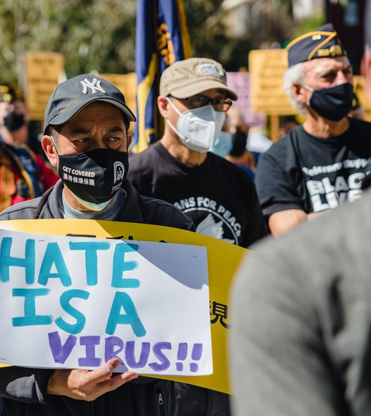
150%
In 2020, Hate Crimes Targeting Asian Americans Spiked by 150% in Major US Cities

Slide 3
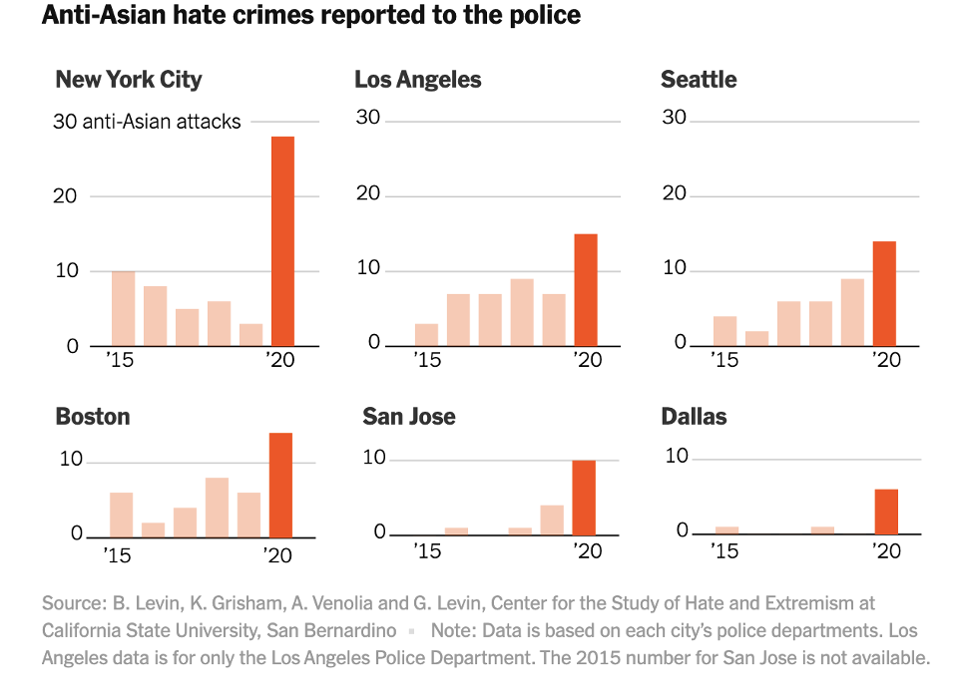
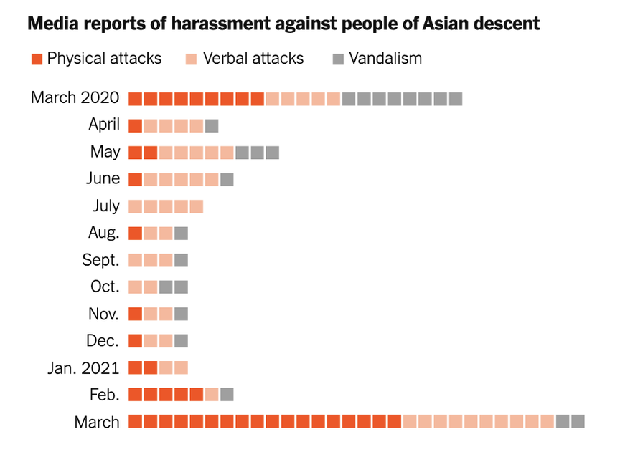
Why does it matter?
A society in which we are all equal is a promise we must fight for everyday

Slide 4
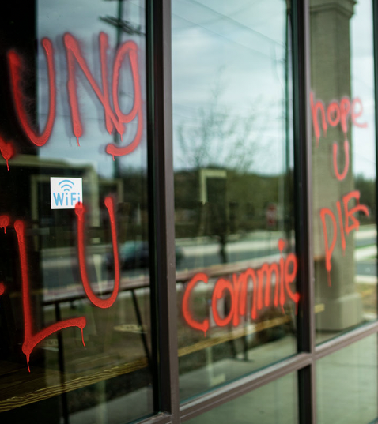
Problem Statement
Regional + trend analysis of the connection between the spread of racist posts on Twitter and violent attacks against Asians in real life
Can we use technology to identify SOURCE of hate against Asian community to decrease the prevalence of violent acts against them?

Slide 5

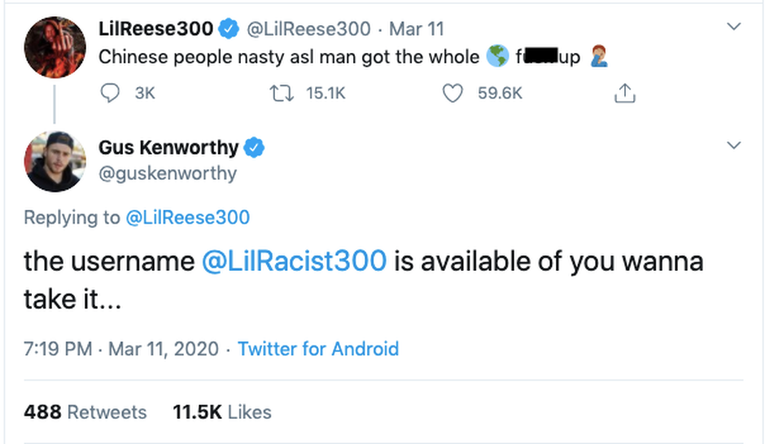
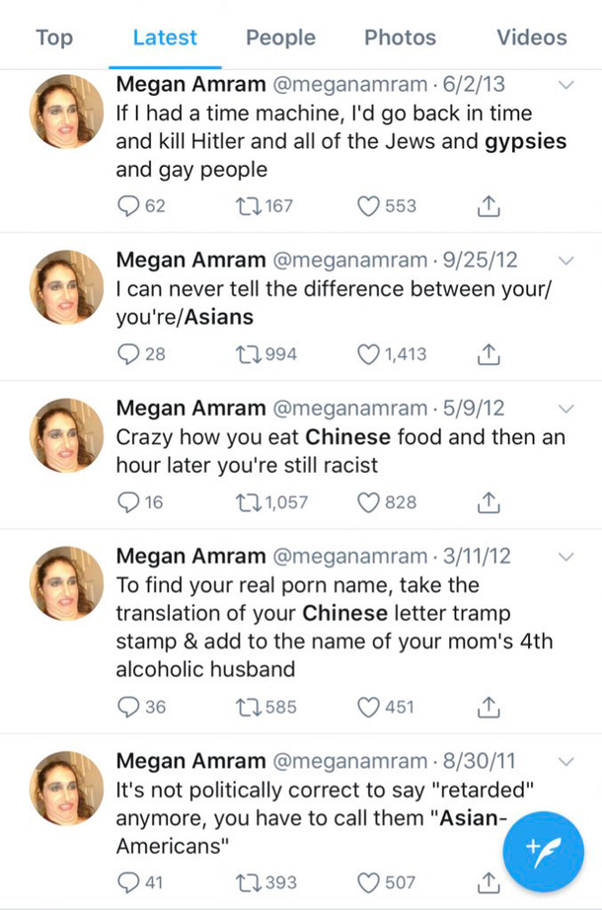

Data Source
Scraped 20000 tweets from Twitter targeting Asians for COVID
Filtered tweets using words like ‘Kung flu’, ‘Go back to your country’, ‘China virus’ and 'Chink'
For each tweet we scraped Timestamp, Tweet ID, Tweet (text/comment), Username, and Location of the tweet, Count of Re-tweets, Location of followers

Slide 6
Methodology
Spacy
Similarity
Positive
Sentiment
Data Cleaning
Word
Frequency
Analysis
Vader
Sentiment
Analysis
Network
Analysis
Negative
Sentiment
Lift
Analytsis

Slide 7
10,000
7,500
5,000
Top Words
in Hateful Tweets
2,500
Most common words related to hate speech against Asians
0
virus
Kungflu
China
Covid
Trump
chink
China virus
realdonaldtrump

Slide 8
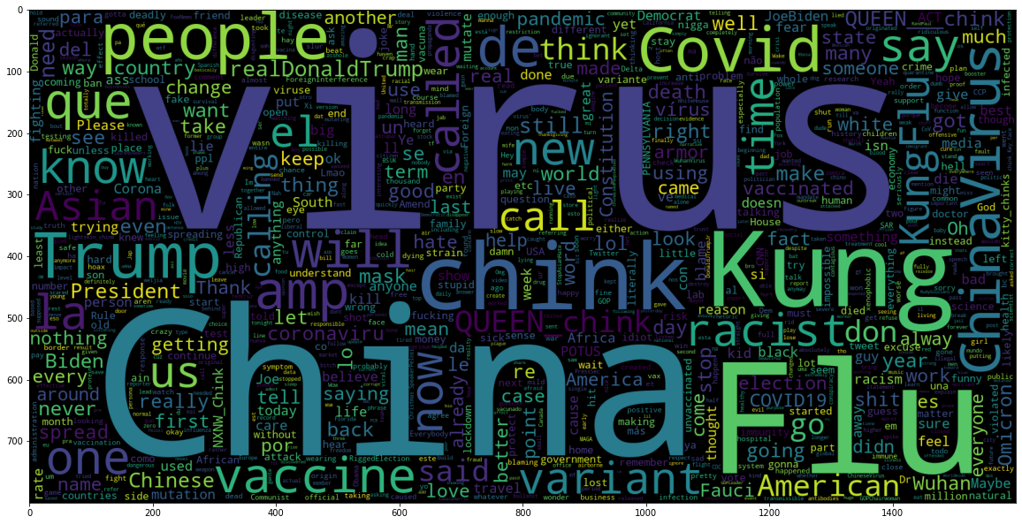
What the Hater's say?

Slide 9
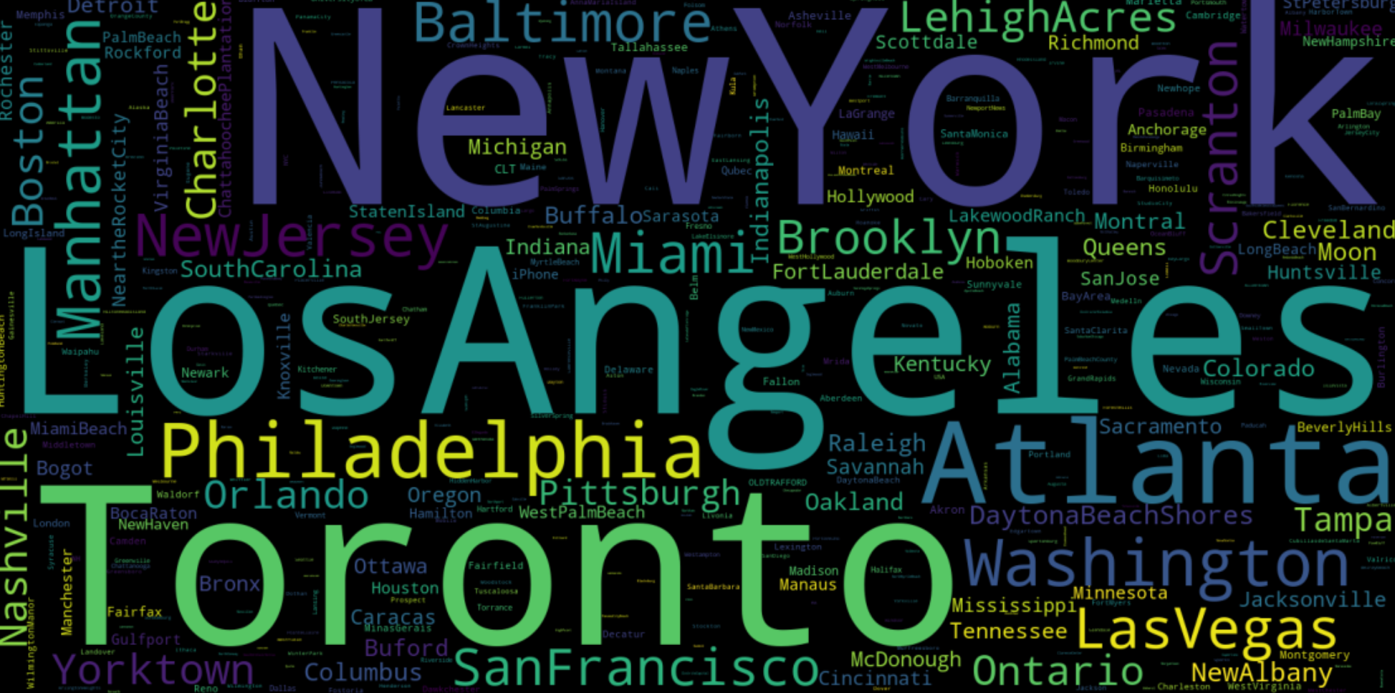
Where are they coming from?

Slide 10
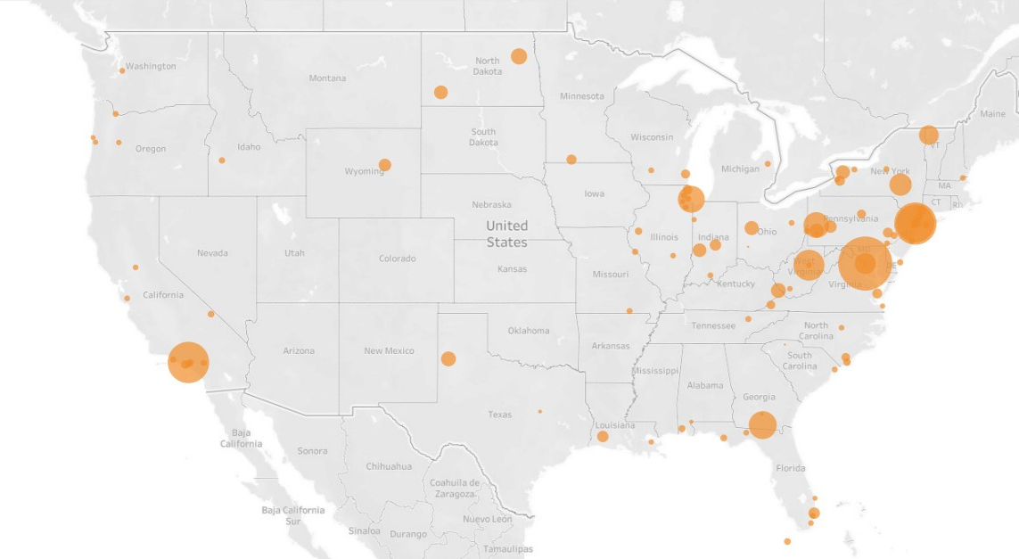
Clusters of Homogenous Tweets
Evidence of clear clusters at US North-East and California
Big cities like Los Angeles, Washington D.C, New York seem to be in the cluster
These cities have significant Asian population and being the political and financial epicenter of the country, anything that happens here attracts worldwide attention
Thus, the impact of discrimination and hate on a group in such cities is much more long-term and systemic and the general feeling of fear and uncertainty spreads throughout the community at large

Slide 11
Word Association Findings
Small cities or suburbs
covid19
Kungflu
chinks
China
New Haven
covid19
Kungflu
chinks
China
Bronx
covid19
0.81
0
1.33
2.58
covid19
0.82
0
1.61
0
Extremely high LIFT scores - for words like KungFlu, chinks
Kungflu
0
0.39
8.60
Kungflu
0
0.39
0
chinks
0.1
1.06
chinks
0.11
13.95
China
0.56
China
0
NY
NY
covid19
Kungflu
chinks
China
fortlauderdale
covid19
Kungflu
chinks
China
reno
covid19
0
0
1.08
2.75
covid19
1.13
0
1.08
2.07
Kungflu
0
0.39
0.92
Kungflu
0
0.39
0
chinks
0.11
0
chinks
0.10
6.81
China
1.95
China
1.80
NY
NY

Slide 12
Word Association Findings
Big Cities
Covid19
Kungflu
Chinks
China
NY
Covid19
Kungflu
Chinks
China
Altlanta
Covid19
3.81
0
1.08
2.61
Covid19
3.80
0
1.08
0.56
High LIFT scores - for words like COVID but not as much for words like KungFlu, chinks
Kungflu
0
0.39
1.19
Kungflu
0
0.39
0.27
Chinks
0.11
0.75
Chinks
0.11
1.27
China
0.96
China
0.63
NY
NY
Covid19
Kungflu
Chinks
China
Los Angeles
Covid19
Kungflu
Chinks
China
Oakland
Covid19
0.82
0
1.34
1.12
Covid19
3.80
0
0.09
1.98
Kungflu
0
0.39
1.19
Kungflu
0
1.87
0
Chinks
0.10
1.75
Chinks
0.11
0.76
China
0.93
China
0.62
NY
NY

Slide 13
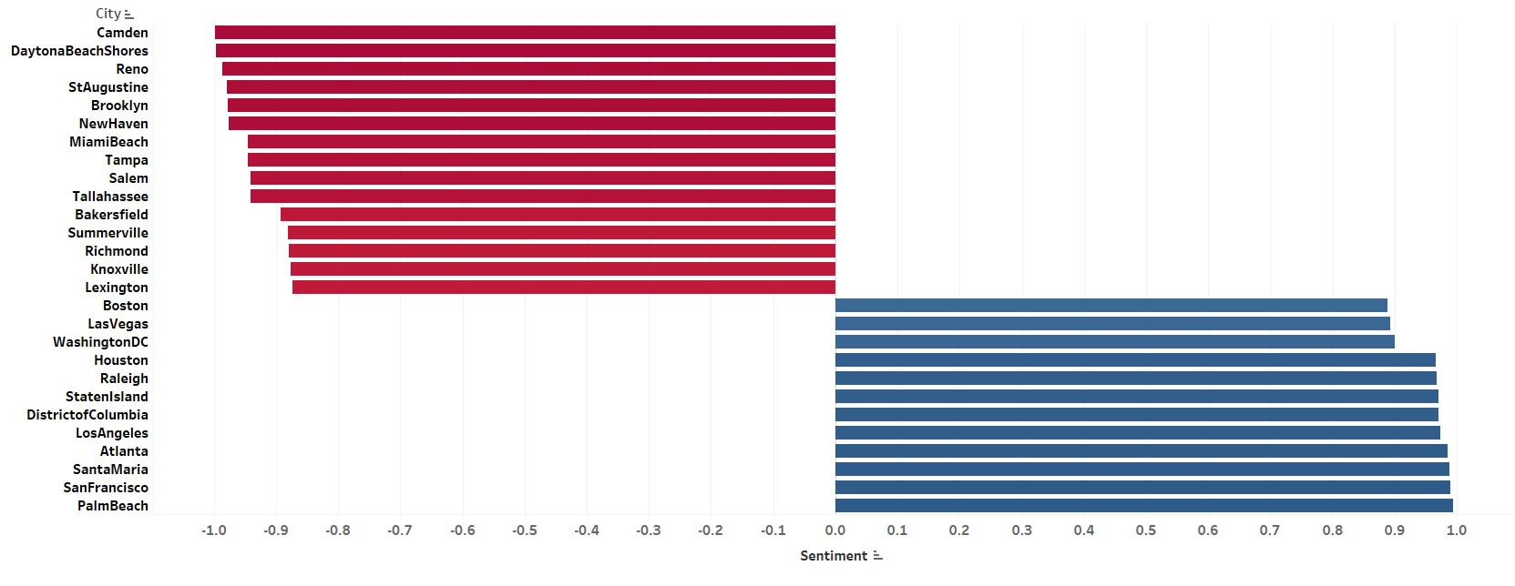
Discovery
Both big and small cities have size-able proportion of negative and positive sentiments.

Slide 14
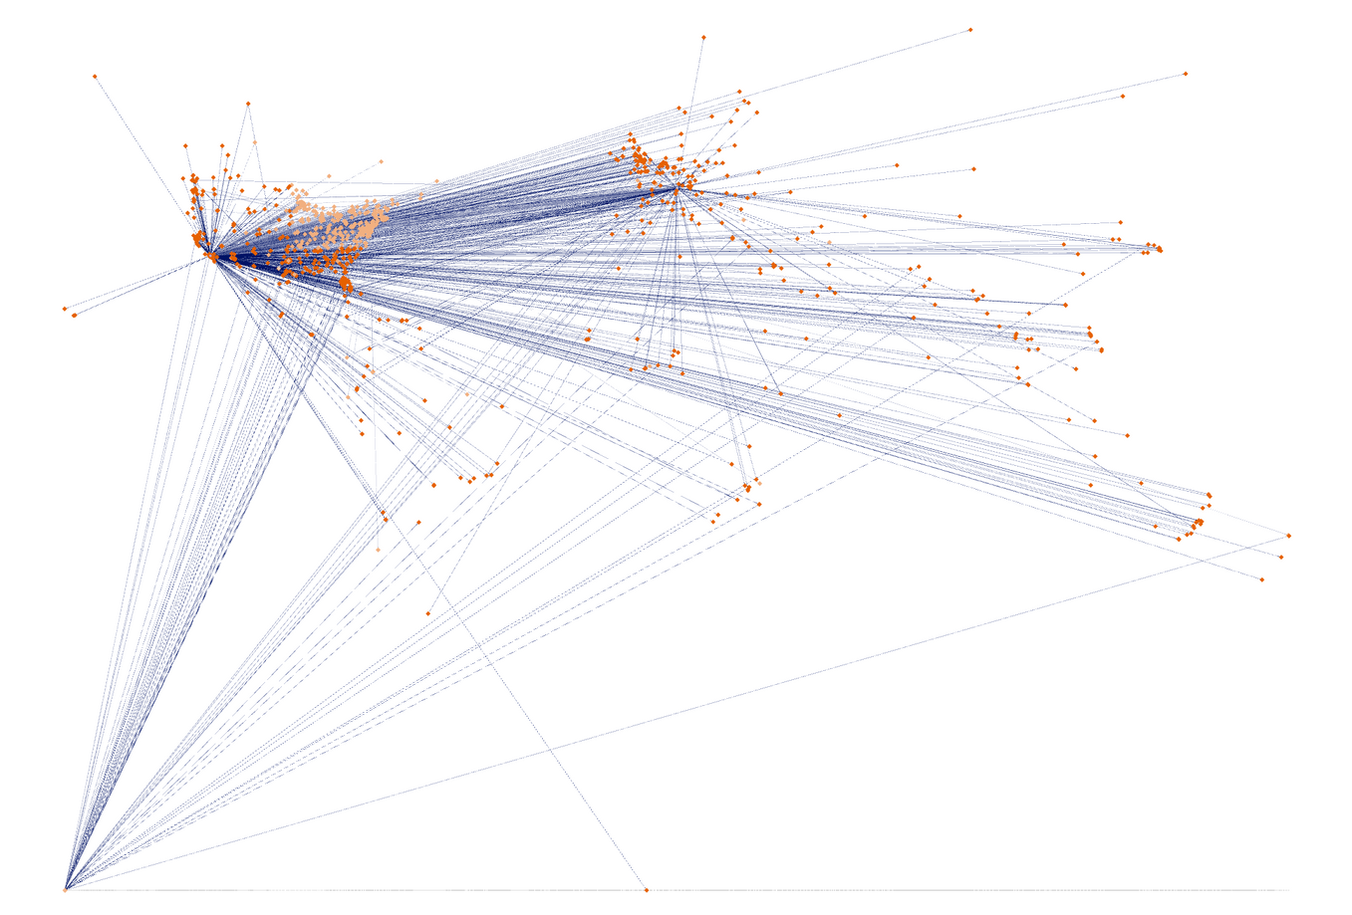
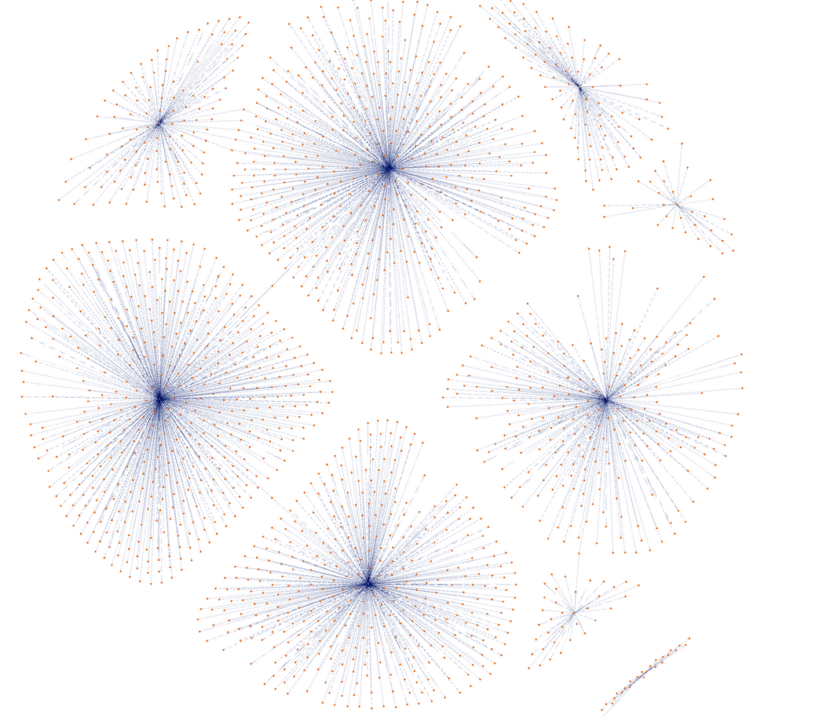
Influencers
User-based
Location-based
High closeness and 1000+ followers for a person
whose tweet had the most negative sentiment.
Profile - Runs a podcast
Location: A big city
5000+ followers for the next 5 users with most negative sentiment.
Typical Profile - Anti-Vaxxers, Anti-LGBTQ
Location: Smaller cities in contrast to LA, NY
Notes:
From the top 10 influencers who had the most negative sentiment, we were able to observe that they tend to locate in a big city like Los Angeles. However, from our findings and further research, we noticed that some users who seem to have negative sentiments were falsely categorized into having negative sentiments.
One of the users was a Japanese American Actor, who directly used words like Kung flu to tell people to stop using racist words. The overall message that he was giving out was advocating no violence towards the Asian community. Some users interacted with users with usernames that contains racial slurs like Chink. However, they did not directly make any negative statements towards the Asian community. Our learning from this analysis is that Network Analysis provides a piece of key information about how negatively influential they could be. However, it isn't always accurate because we are only looking at the words they use instead of the context.

Slide 15
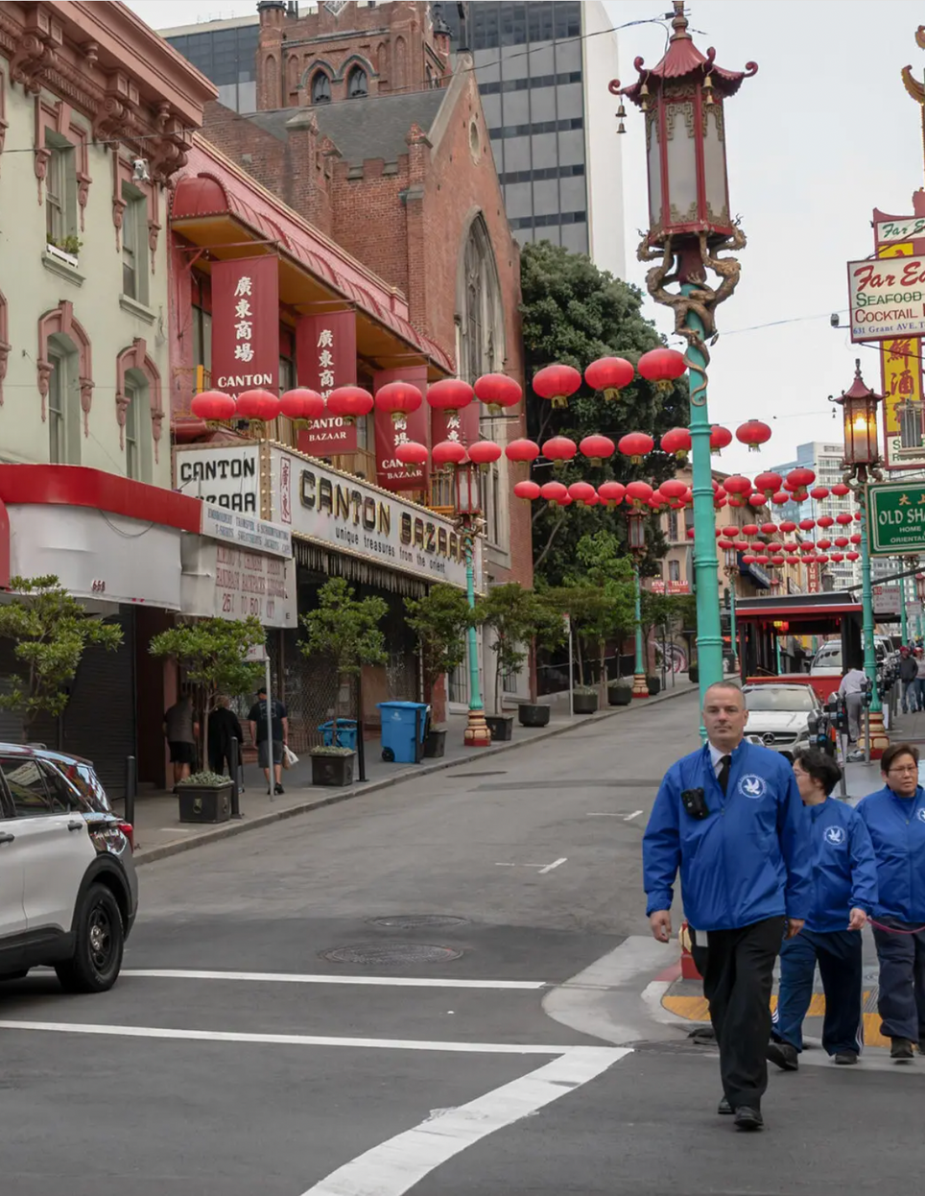
Uncomfortable Truth
Big Cities like San Francisco, Los Angeles , Washington DC that witnessed majority of violence against Asians exhibited positive sentiments.
On the other hand, most of the smaller cities did not report any major anti-Asian hatred incidents; however, they have clearly displayed high negative sentiments.
Scores reveal that smaller cities and towns which might not be in NEWS otherwise, may actually be playing an important role in spreading hate.

Slide 16
Recommendations
Influencers
Clusters
Algorithms
Classify/ Monitor Tweets
from Influencers
Handle and identify HATE in unstructured
formats - podcasts,
links, videos, and audio
Preventative efforts to mitigate bias
Pro-actively identify clusters - including smaller cities
Sentiment score for San Francisco (0.9901) is more positive than sentiment score for Camden(-0.9982)
Algorithms should not be confined to analyzing the volume of tweets coming from a specific location
Analytics should include sentiments relative to that location
Sentiments can also be misleading as users may be using words that appear hateful but are actually intending to STOP the spread. VADER sentiment did not catch such sentiments as positive
Notes:
Retweets-
Can you believe there are 1000s of articles for etiquette when retweeting? and Influencers are leveraging this so they can make a successful tweet.

Slide 17

W
FIGHT THE VIRUS.
FIGHT THE BIAS.

